Slide 1
Bowed String Instrument Modeling
Louis Deng
260656496

Slide 2
Objective
Synthesize a bowed string sound using basic waveforms and digital synthesis techniques
Implement an instrument body with a particular resonance response using delay-lines and/or filters
In MaxMSP
Notes:
digi/delay
didnt have a set goal of instrument i want to implement, but was aiming for a violin

Slide 3
Challenges
MaxMSP has limitations in sample-wise calculation
✋ do actual physical modeling calculation in [gen~]
✋ recreate ‘bowed.cpp’ from stk
MaxMSP is good at
👉 straight forward synthesis
👉 customized parameter exploration
Notes:
initially, wanted to do a lossy wave propagation phys modl.
dr.scavone suggests that i should implement bowed.cpp in max, stk: difficult to implement due to the environment that max provides is not friendly to sample-based calc
this is not actual physical modeling, but used some techniques with filters to recreate the real-life scenario that would occur in a string instrument body
good at straight forward implementation of synthesis
and exploring different parameter options

Slide 4
Approach – Pt. I
Bowed string waveform synthesis
bow strokes will excite the string - microscopic ‘jumps’
resulting spectrum has to be rich
Notes:
project design
some characteristics of the bow and string interactions
to simulate the jumps: use amplitude modulation to “gate” a basic waveform using a square wave
the resulting spectrum will be sawtooth like or square like

Slide 5
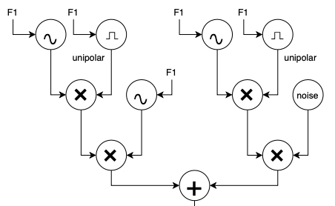
Approach – Pt. I
AM - small duty cycles for square waves
noise: 0.03
sine: 0.27
Gated signal then modulates sine wave and noise
to mimic the tonal and scratchy part of the sound
Notes:
first, sine wave is AM’d by a unipolar square wave with a duty cycle < 0.5
more than a half of the gated signal will be silent (draw)

Slide 6
Approach – Pt. II
Instrument body
bowed string sound will be ‘painted’ by the instrument body, due to the resonance property of the body
Notes:
part 2 of making this string instrument is to add an instrument body
most of the focus of the project is on this part
the synthesized string sound is dry, and fake
need some resonance structure and filters to build up color

Slide 7
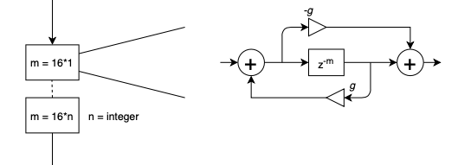
Approach – Pt. II
Schroeder all-pass filter cascades
integer multiples of a small number as delay
’g’ is different for each all-pass section
up to 7 all-pass filters
Adds space!
tiny reverb with flat response
some interesting phase response*
Notes:
same in the lecture slides
but instead of using mutually prime large delay numbers as in the schroeder late reverb design
use integer multiples of a small number

Slide 8
Approach – Pt. II
Resonance filters (cascade of second-order sections)
filter parameters are borrowed from bowed.cpp
Adds colour!
Notes:
after that to add colour
use 2nd order resonance filters
quite a bit wooden color

Slide 9
demo

