Slide 1
Sound examples to accompany
Chapter 2: Musical timbre perception by Stephen McAdams
The Psychology of Music, 3rd ed., 2013
D. Deutsch, editor
Elsevier, San Diego, CA

Slide 2
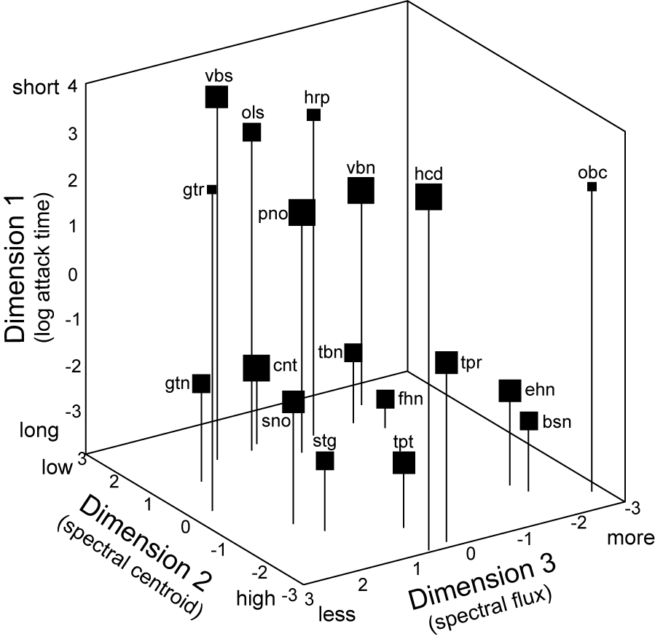

Figure 2. The sounds used in the timbre space study by McAdams, Winsberg, Donnadieu, Krimphoff & De Soete (1995) based on FM-synthesis algorithms created by Wessel, Bristow & Settle (1987). Click on the speaker icons to hear them. Play sequences along each dimension to get a sense of the perceptual meaning of each dimension.

Slide 3
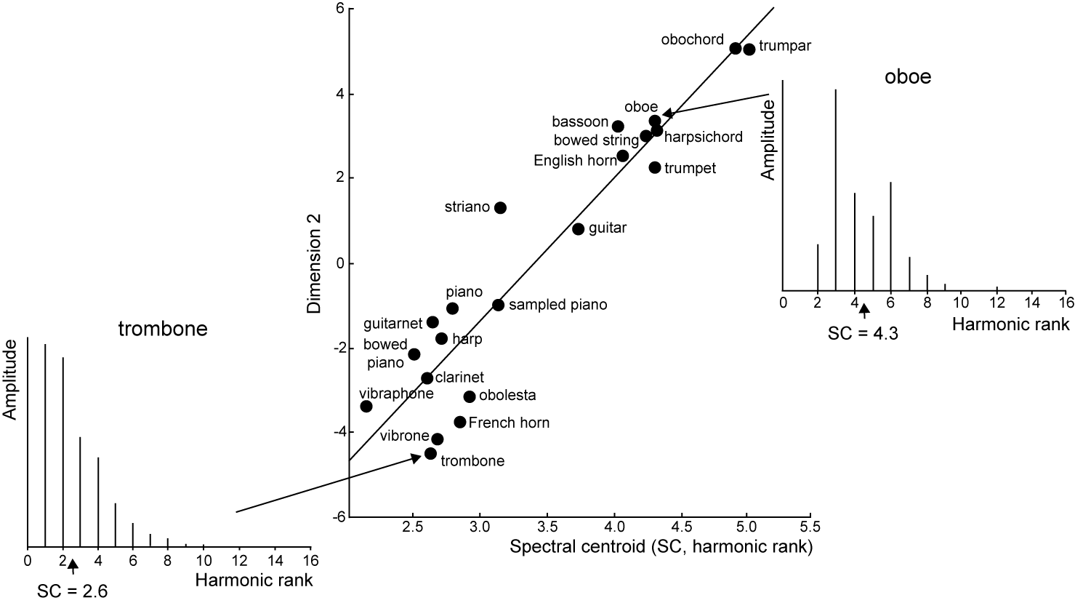
Figure 4. Examples of two sounds near the extremes of Dimension 2 of the Krumhansl (1989) timbre space as analyzed acoustically by Krimphoff, McAdams & Winsberg (1994). Click on the speaker icon to hear the sounds. Compare their difference in brightness and/or nasality. The corresponding acoustic descriptor is spectral centroid.

Slide 4
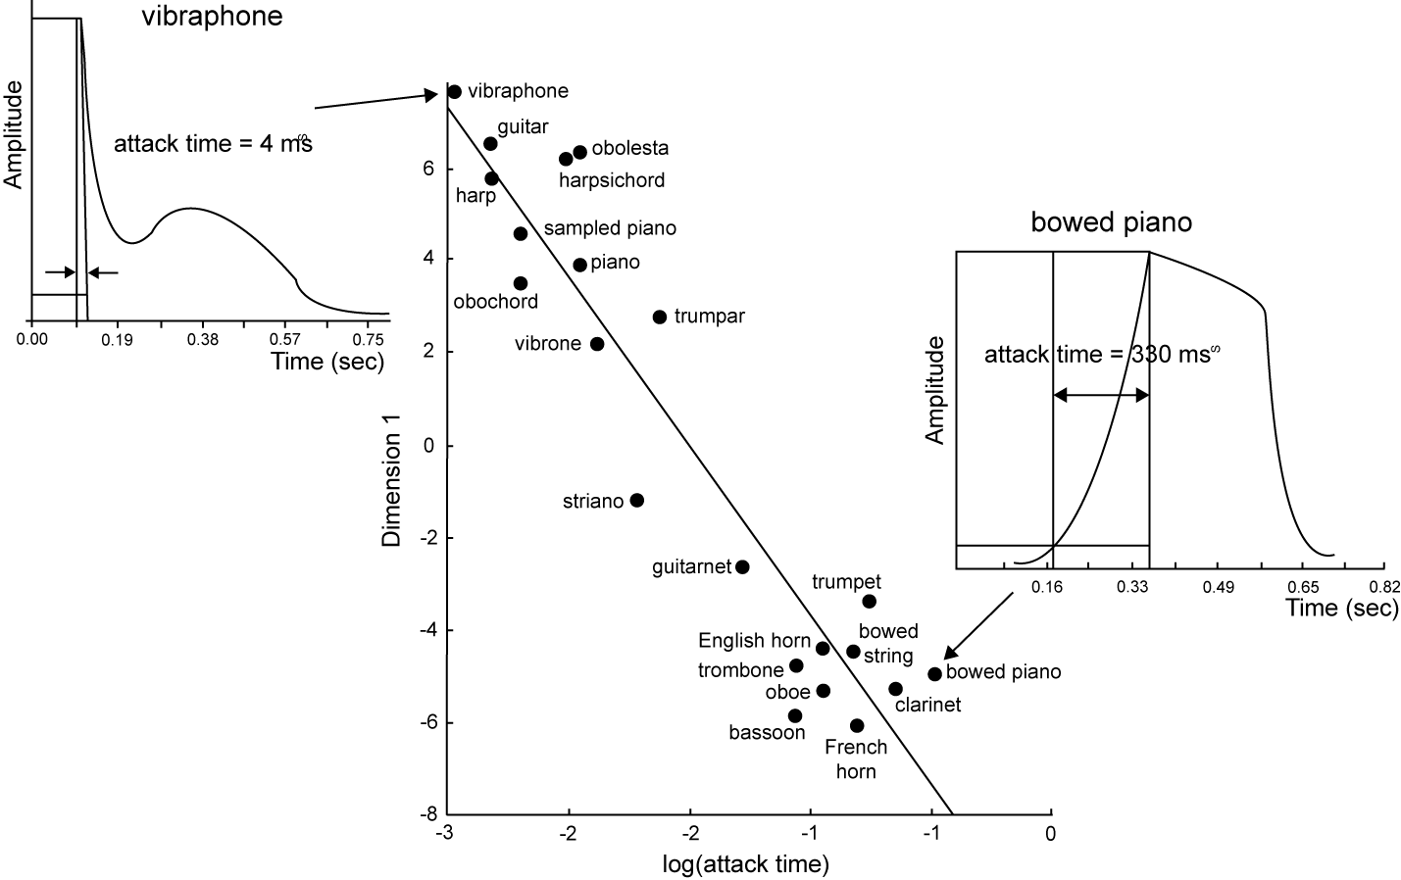
Figure 5. Examples of two sounds near the extremes of Dimension 1 of the Krumhansl (1989) timbre space as analyzed acoustically by Krimphoff, McAdams & Winsberg (1994). Click on the speaker icon to hear the sounds. Compare their difference in sharpness of attack. The corresponding acoustic descriptor is the logarithm of the attack time.

Slide 5
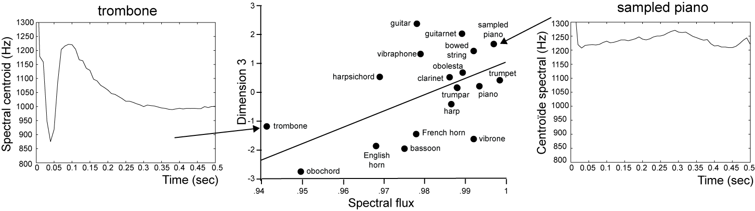
Figure 6. Examples of two sounds near the extremes of Dimension 3 of the McAdams et al. (1995) timbre space as analyzed with the Timbre Toolbox (Peeters, Giordano, Susini, Misdariis & McAdams, 2011). Click on the speaker icon to hear the sounds. Compare their difference in the degree of variation in tone color over the course of the sound. The corresponding acoustic descriptor is spectral flux or the degree of variation of the spectral centroid over time.

Slide 6
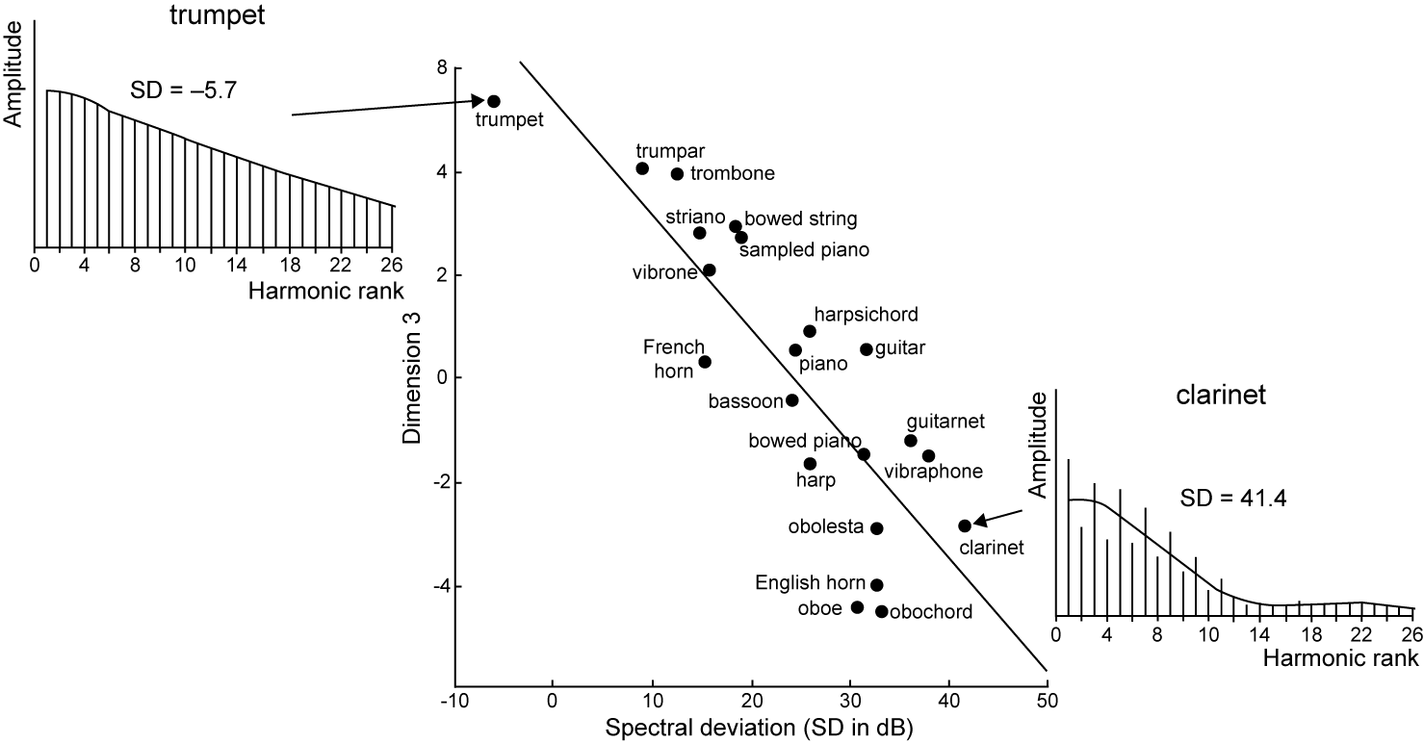
Figure 7. Examples of two sounds near the extremes of Dimension 3 of the Krumhansl (1989) timbre space as analyzed acoustically by Krimphoff, McAdams & Winsberg (1994). Click on the speaker icon to hear the sounds. Compare their difference in richness or hollowness. The corresponding acoustic descriptor is spectral deviation.

Slide 7
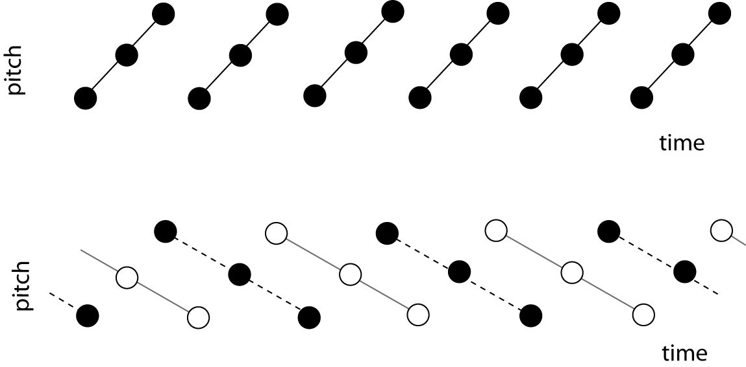
Figure 9. Two sound sequences created by Wessel (1979) to demonstrate that auditory streams can be formed on the basis of timbral similarity. When ascending triplets are played with the same timbre, one hears ascending triplets. But when successive notes alternate between very different timbres, two interleaved streams of descending triplets are heard.

Slide 8
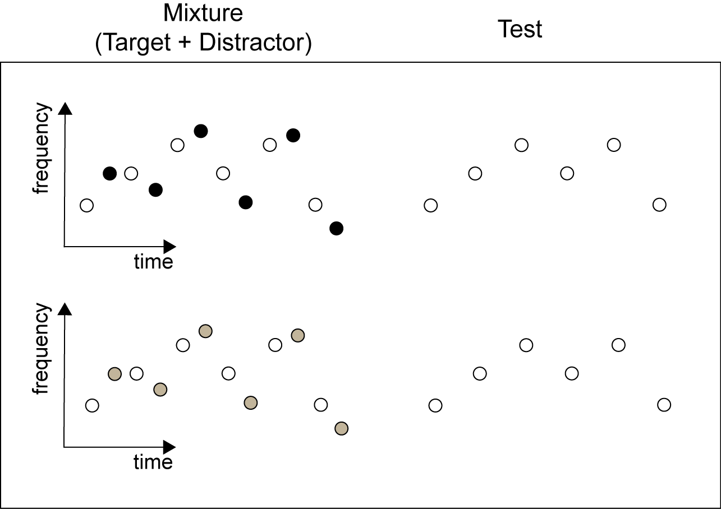
Figure 10. Stimuli used by Bey & McAdams (2003). A mixture of target and distractor melodies is played first, followed by an isolated test melody. The timbral difference between target and distractor is varied. Listen to various degrees of difference by clicking on the speaker icons. Decide whether the test melody was the same as or different from the target melody. In the control condition, no distractor was presented.
Timbral differences between target & distractor melodies
Large
Medium
Small
Identical
Control
Answers: Large = different, Medium = same, Small = different, Identical = same, Control = same.

Slide 9
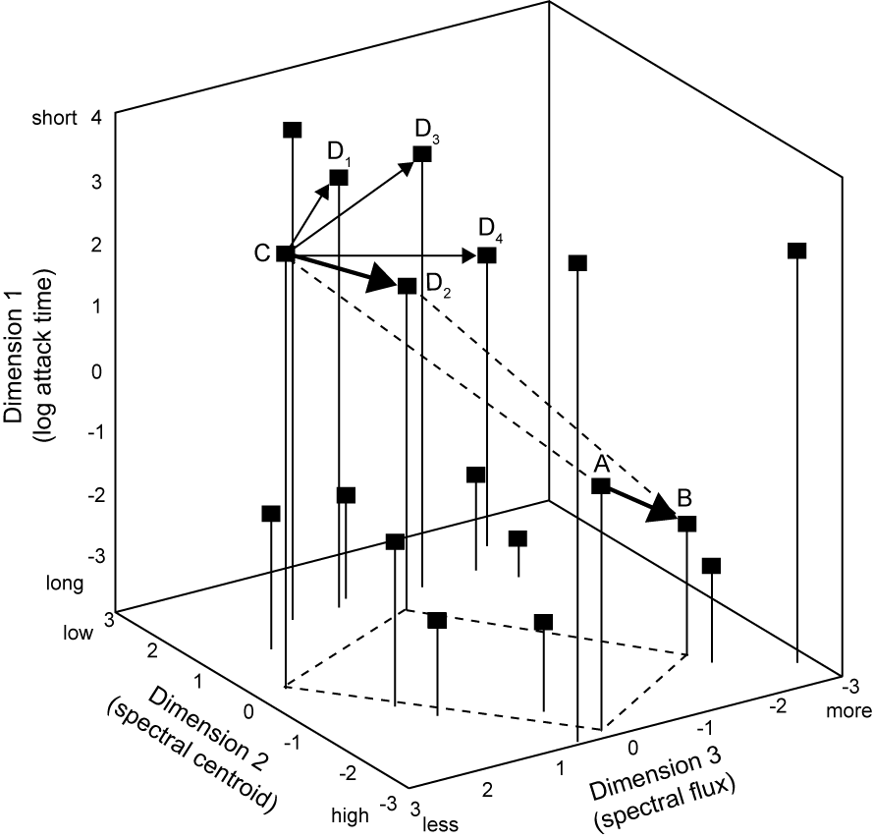
Figure 13. The timbre interval that is most similar to AB is CD₂. Note the nearly perfect parallelogram relation between the two vectors. For visualization purposes, the parallelogram is projected onto the Dimension2-Dimension3 plane. Compare AB to CD₁, CD₂, CD₃ and CD₄. Which D best fits the analogy, A is to B as C is to D?

Slide 10
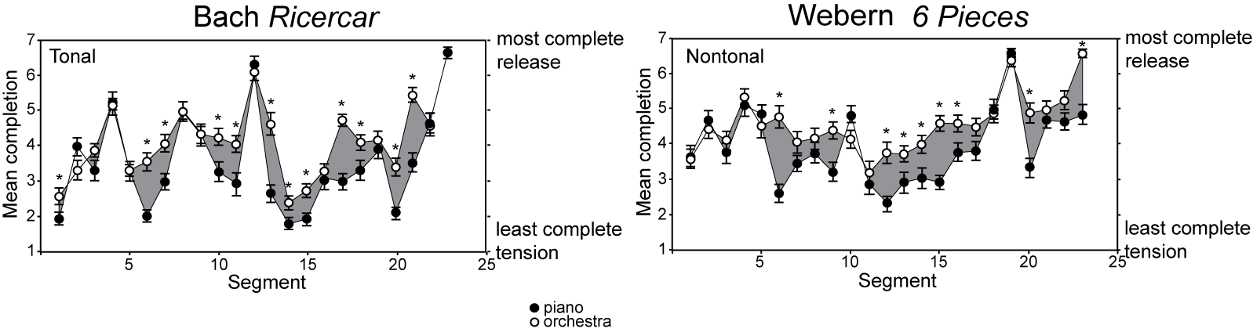
Figure 14. Examples from the Paraskeva & McAdams (1997) study on the role of timbre in creating musical tension. A piece is played and then stopped, and listeners must rate the degree of musical completion. A tonal piece by Bach and an atonal piece by Webern were played either in full orchestral versions or in piano versions. Stop points 4 (little difference between piano and orchestra versions) and 6 (large differences between the versions) are given. The icons at the top are for orchestra, and those at the bottom are for piano. Compare the relative sense of completion at the end of each excerpt.

Slide 11
Figure 15. Learning sequences used by Tillmann & McAdams (2004). In S1, successive timbres within triplets are close together in timbre space and adjacent triplets are far apart, so timbral discontinuity and transition probabilities are congruent. In S2, they are incongruent, and in S3, they are neutral. Click on the speaker icons to hear 15” of each sequence.

